Slide 1

Module 3 –Java Inheritance and Polymorphism
Lecturer: Jay A. Abaleta

Slide 2
What is Inheritance?
Inheritance in Java is a mechanism in which one object acquires all the properties and behaviors of a parent object.
It is an important part of OOPs (Object Oriented programming system).

Slide 3

Terms Used in Inheritance
Class: A class is a group of objects which have common properties. It is a template or blueprint from which objects are created.
Sub Class/Child Class: Subclass is a class which inherits the other class. It is also called a derived class, extended class, or child class.
Super Class/Parent Class: Superclass is the class from where a subclass inherits the features. It is also called a base class or a parent class.
Reusability: As the name specifies, reusability is a mechanism which facilitates you to reuse the fields and methods of the existing class when you create a new class. You can use the same fields and methods already defined in the previous class.

Slide 4

What is extends keyword?
The extends keyword indicates that you are making a new class that derives from an existing class.
The meaning of "extends" is to increase the functionality.
In the terminology of Java, a class which is inherited is called a parent or superclass, and the new class is called child or subclass.

Slide 5
Syntax of Inheritance
class Subclass-name extends Superclass-name
{
//methods and fields
}

Slide 6
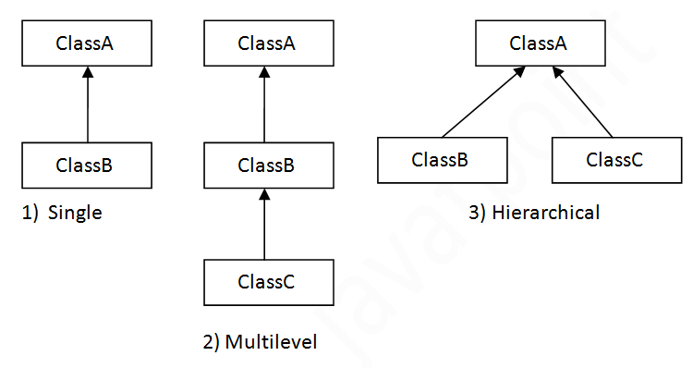
Types of Inheritance in JAVA

Slide 7
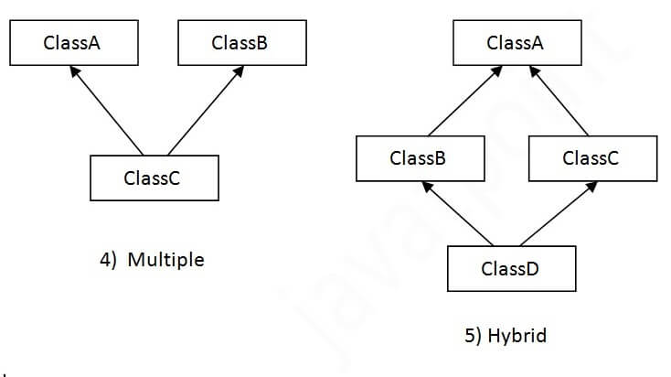
Types of Inheritance in JAVA

Slide 8
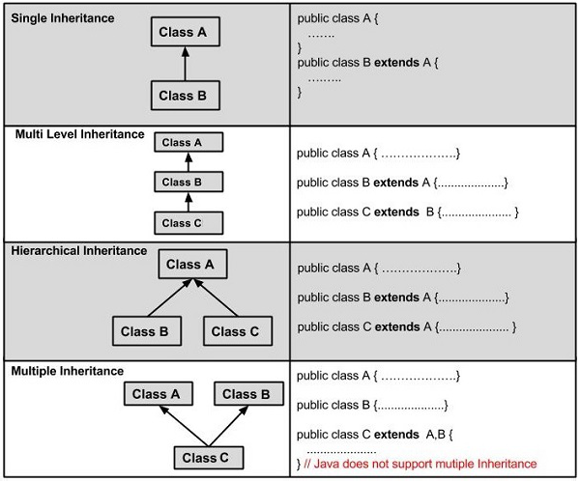
Types of Inheritance in JAVA

Slide 9
A relationship of extends keyword is used to achieve inheritance.
Example:
public class Animal {
}
public class Mammal extends Animal {
}
public class Reptile extends Animal {
}
public class Dog extends Mammal {
}
Explanation:
Animal is the superclass of Mammal class.
Animal is the superclass of Reptile class.
Mammal and Reptile are subclasses of Animal class.
Dog is the subclass of both Mammal and Animal classes.

Slide 10

Polymorphism
Polymorphism is considered one of the important features of Object-Oriented Programming.
Polymorphism allows us to perform a single action in different ways. In other words, polymorphism allows you to define one interface and have multiple implementations.
The word “poly” means many and “morphs” means forms, So it means many forms.
OBJECT-ORIENTED PROGRAMMING
Course Code: CCOBJPGL

Slide 11
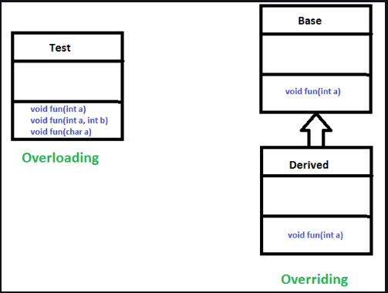
Types of Polymorphism
Compile-time (static binding) – the object type is resolved at compilation of code
Run-time (dynamic binding) – the object type is resolved at runtime, not during compilation
OBJECT-ORIENTED PROGRAMMING
Course Code: CCOBJPGL

Slide 12

Note
Overloading – resolved at compile time
Overriding – resolved at run time
Private, final and static methods and variables uses static binding and bonded by compiler
OBJECT-ORIENTED PROGRAMMING
Course Code: CCOBJPGL

Slide 13

Typecasting objects
One object reference can be typecast into another object reference. This is called casting object.
Implicit and explicit casting.
A nature of polymorphism.
OBJECT-ORIENTED PROGRAMMING
Course Code: CCOBJPGL

Slide 14

Implicit typecasting
The statement Employee f1 = new Faculty(), known as implicit casting, is legal because an instance of Faculty is an instance of Employee.
This casting is also known as upcasting, because an instance of a subclass is always an instance of its superclass.
Employee
Faculty
OBJECT-ORIENTED PROGRAMMING
Course Code: CCOBJPGL

Slide 15


Explicit typecasting
This won’t work. Even though f1 is already a Faculty object, the compiler is not smart enough to recognize it. You need to explicitly state the type.
This casting is also known as upcasting, because an instance of a subclass is always an instance of its superclass.
Employee
Faculty
OBJECT-ORIENTED PROGRAMMING
Course Code: CCOBJPGL

Slide 16
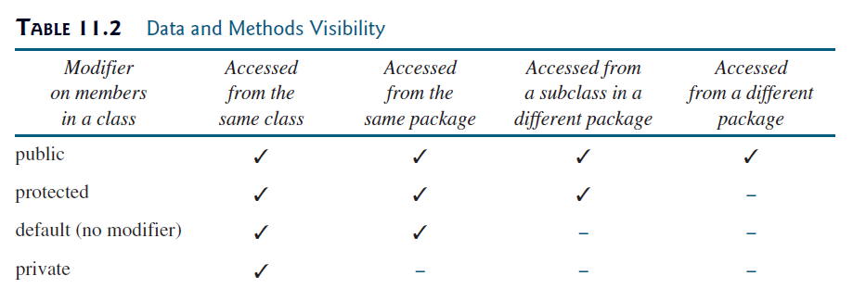
Access Modifiers
OBJECT-ORIENTED PROGRAMMING
Course Code: CCOBJPGL

